Slide 1
Game Trees:
MiniMax strategy, Tree Evaluation, Pruning, Utility evaluation

Slide 2
Problem Reduction Search:
AND/OR Graphs & Game Trees

Slide 3
Problem Reduction Search
Typically where we are planning how best to solve a problem that can be recursively decomposed into sub-problems in multiple ways
  Matrix multiplication problem
  Tower of Hanoi and Blocks World problems
  Finding shortest proofs in theorem proving

Slide 4
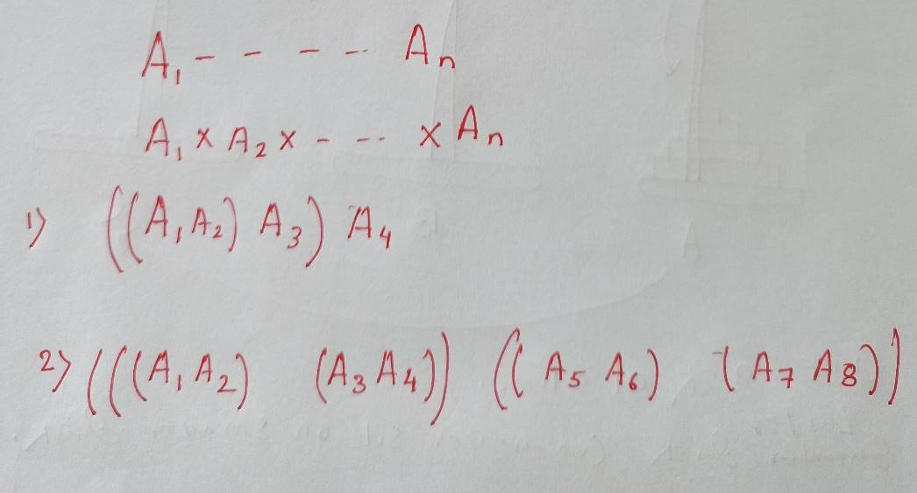
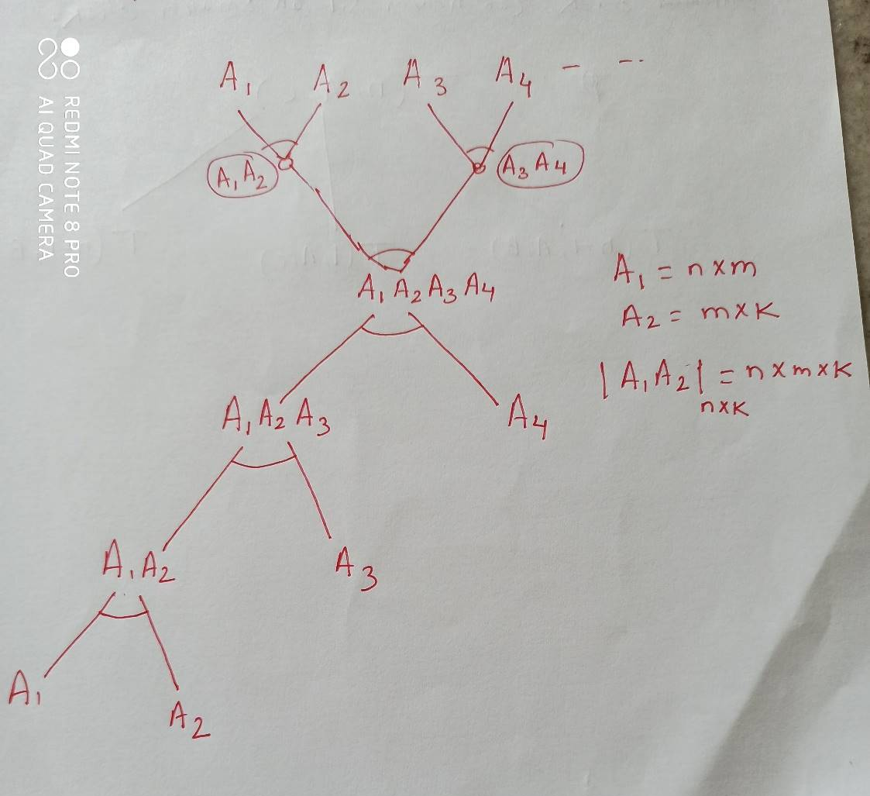

Slide 5
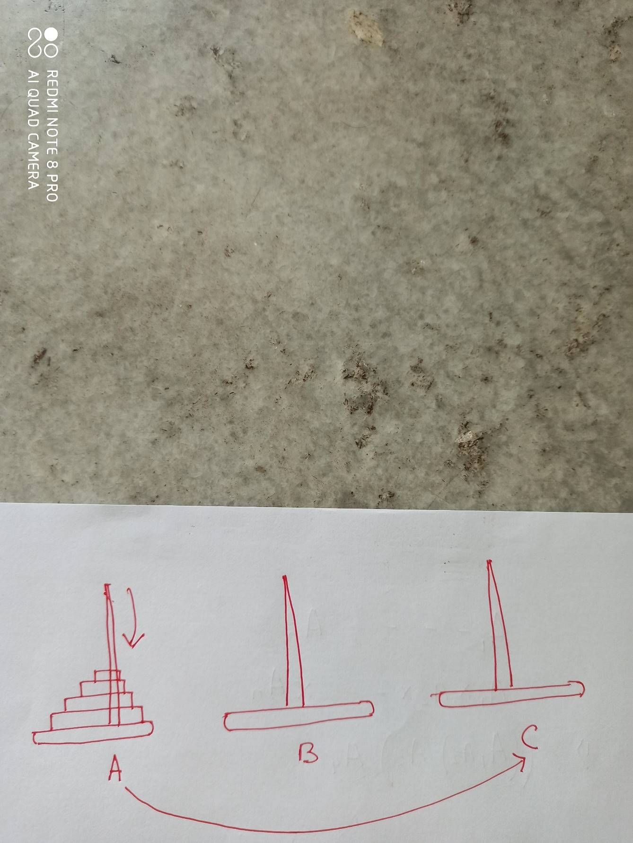
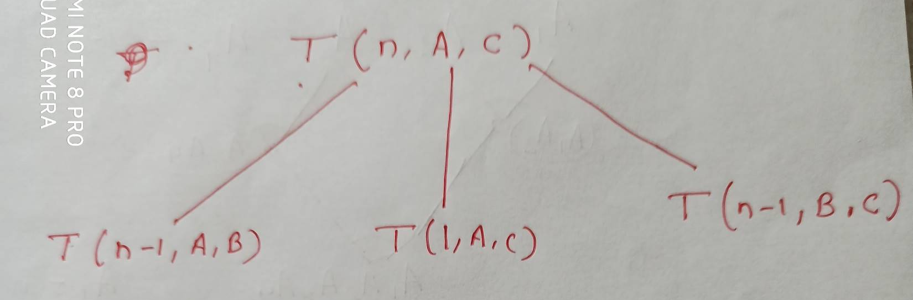

Slide 6
AND/OR Graphs
  An OR node represents a choice between possible decompositions
  An AND node represents a given decomposition
Game Trees
  Max nodes represent the choice of my opponent
  Min nodes represent my choice

Slide 7
The AND/OR graph search problem
Problem definition:
  Given: [G, s, T] where
    G is the (possibly implicitly specified) AND/OR graph
    s is the start node of the AND/OR graph
    T is the (possibly implicitly specified) set of terminal nodes
    h(n) is a heuristic function estimating the cost of solving the sub-problem represented by node n
  To find:
    A minimum cost solution tree
During the search, we will use G* to denote the explicit portion of the AND/OR graph

Slide 8

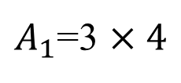
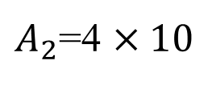
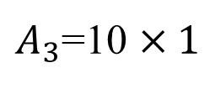



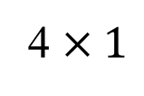
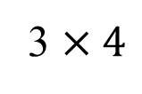

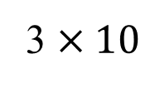


OR
30+120
= 150
AND
12+40
= 52
AND
(0)
(40)
(0)
(120)

Slide 9
h =7
h =10
h =14
h =16
h =18
AND
2
1
h =8
h =6
h =16
h =4
h =3
h =7
OR
OR
16
8
h =14
2
6
0
1
0
h =2
AND
h =7
h =5
AND
9
7
1
0
0
h =3
0
10
3
4

Slide 10
Algorithm AO*
Initialize: Set G* = {s}, f(s) = h(s)
If s ∈ T, label s as SOLVED
Terminate: If s is SOLVED, then terminate
Select: Select a non-terminal leaf node n from the marked sub-tree below s in G*
Expand: Make explicit the successors of n
For each successor, m, not already in G*:
Set f(m) = h(m)
If m is a terminal node, label m as SOLVED
Cost Revision: Call cost-revise(n)
Loop: Go To Step 2.

Slide 11
Cost Revision in AO*: cost-revise(n)
Create Z = {n}
If Z = { } return
Select a node m from Z such that m has no descendants in Z
If m is an AND node with successors r₁, r₂, … r_{k}:
    Set f(m) = Σ [ f(r_{i}) + c(m, r_{i}) ]
    Mark the edge to each successor of m
    If each successor is labeled SOLVED, then label m as SOLVED
If m is an OR node with successors r₁, r₂, … r_{k}:
    Set f(m) = min { f(r_{i}) + c(m, r_{i}) }
    Mark the edge to the best successor of m
    If the marked successor is labeled SOLVED, label m as SOLVED
If the cost or label of m has changed, then insert those parents of m into Z for which m is a marked successor
Go to Step 2.

Slide 12
Searching OR Graphs
How does AO* fare when the graph has only OR nodes?
What are the roles of lower-bound and upper-bound estimates?
  Pruning criteria: LB > UB
Searching Game Trees
Consider an OR tree with two types of OR nodes, namely Min nodes and Max nodes
In Min nodes we select the minimum cost successor
In Max nodes we select the maximum cost successor
Terminal nodes are winning or loosing states
  It is often infeasible to search up to terminal nodes
  We use heuristic costs to compare non-terminal nodes

Slide 13
Shallow and Deep Pruning
ROOT
ROOT
A
10
B
10
F
Max node
14
C
D
G
Min node
5
E
Shallow Cut-off
Deep Cut-off

Slide 14
Alpha-Beta Pruning
Alpha Bound of J:
  The highest current value of all MAX ancestors of J
  Exploration of a min node, J, is terminated as soon as its value equals or falls below alpha.
  In a min node, we update beta
Beta Bound of J:
  The lowest current value of all MIN ancestors of J
  Exploration of a max node, J, is terminated as soon as its value equals or exceeds beta
  In a max node, we update alpha
In both min and max nodes, we return when α ≥ β

Slide 15
Alpha-Beta Procedure: V(J;α,β)
If J is a terminal, return V(J) = h(J).
If J is a max node:
  For each successor J_{k} of J in succession:
  Set α = max { α, V(J_{k}; α, β) }
  If α ≥ β then return β, else continue
  Return α
If J is a min node:
For each successor J_{k} of J in succession:
  Set β = min { β, V(J_{k}; α, β) }
  If α ≥ β then return α, else continue
  Return β

Slide 16
Searching OR Graphs
Searching Game Trees
Consider an OR tree with two types of OR nodes, namely Min nodes and Max nodes
In Min nodes we select the minimum cost successor
In Max nodes we select the maximum cost successor
Terminal nodes are winning or loosing states
  It is often infeasible to search up to terminal nodes
  We use heuristic costs to compare non-terminal nodes

Slide 17
Two-Person Perfect Information Deterministic Game
Two players take turns making moves
Board state fully known, deterministic evaluation of moves
One player wins by defeating the other (or else there is a tie)
Want a strategy to win, assuming the other person plays as well as possible

Slide 18
Minimax
Create a utility function
  Evaluation of board/game state to determine how strong the position of player 1 is.
  Player 1(max) wants to maximize the utility function
  Player 2 (min) wants to minimize the utility function
Minimax tree
  Generate a new level for each move
  Levels alternate between “max” (player 1 moves) and “min” (player 2 moves)

Slide 19
Game tree
Max
X
 | X
 | X
Min
X
 | O
X | O
O | X
 | X
 | O
 | X
O
 | X
 |  | O
O
 | X
 | O
 | X
Max
Min
…
X
X | O
X
 | O
X
X
 | O
 |  | X
X | O
 | X

Slide 20
W
L
L
W
L
L
W
W
L
W
W
W
L
L
L
W
L

Slide 21
10
Max
Min
2
10
14
20
10
2
10
13
2
9
14
1
3
20
10
11
9
12
14
15
13
14
5
2
4
1
3
22
20
21

Slide 22
Minimax tree
Max
Min
Max
Min

Slide 23
Minimax Tree Evaluation
Assign utility values to leaves
  Sometimes called “board evaluation function”
  If leaf is a “final” state, assign the maximum or minimum possible utility value (depending on who would win)
  If leaf is not a “final” state, must use some other heuristic, specific to the game, to evaluate how good/bad the state is at that point

Slide 24
Minimax tree
Max
Min
Max
100
Min
23
28
21
-3
12
4
70
-3
-12
-70
-5
-100
-73
-14
-8
-24

Slide 25
Minimax Tree Evaluation
At each min node, assign the minimum of all utility values at children
  Player 2 chooses the best available move
At each max node, assign the maximum of all utility values at children
  Player 1 chooses best available move
Push values from leaves to top of tree

Slide 26
Minimax tree
Max
Min
Max
28
-3
12
70
-3
100
-73
-14
-8
Min
23
28
21
-3
12
4
70
-3
-12
-70
-5
-100
-73
-14
-8
-24

Slide 27
Minimax tree
Max
Min
-4
-3
-73
Max
21
-3
12
70
-4
100
-73
-14
-8
Min
23
28
21
-3
12
4
70
-4
-12
-70
-5
-100
-73
-14
-8
-24

Slide 28
Minimax tree
Max
-3
Min
-4
-3
-73
Max
21
-3
12
70
-4
100
-73
-14
-8
Min
23
28
21
-3
12
4
70
-4
-12
-70
-5
-100
-73
-14
-8
-24

Slide 29
Minimax Complexity Evaluation
Given average branching factor b, and depth m:
  A complete evaluation takes time b^{m}
  A complete evaluation takes space bm
Usually, we cannot evaluate the complete state, since it’s too big
Instead, we limit the depth based on various factors, including time available.

Slide 30
MINIMAX Algorithm
A NIM game is played between two players.
The game starts with an odd number of match sticks, normally 7 or 9, placed on a single row, called a pile. Each player in his turn has to break a single pile into two piles of unequal sticks, greater than zero. The game will come to an end when either of the two players cannot give a successful move. The player who cannot give a successful move the first time will lose the game.

Slide 31
Steps of NIM Game
You have 7matches sticks
The first player is requested to divide the matches into two unequal piles
The next player works on the piles and divide one of them into two unequal piles
Each player takes a turn and tries to divide until no more piles are divisible into unequal piles
The player who can not divide anymore loses the game

Slide 32
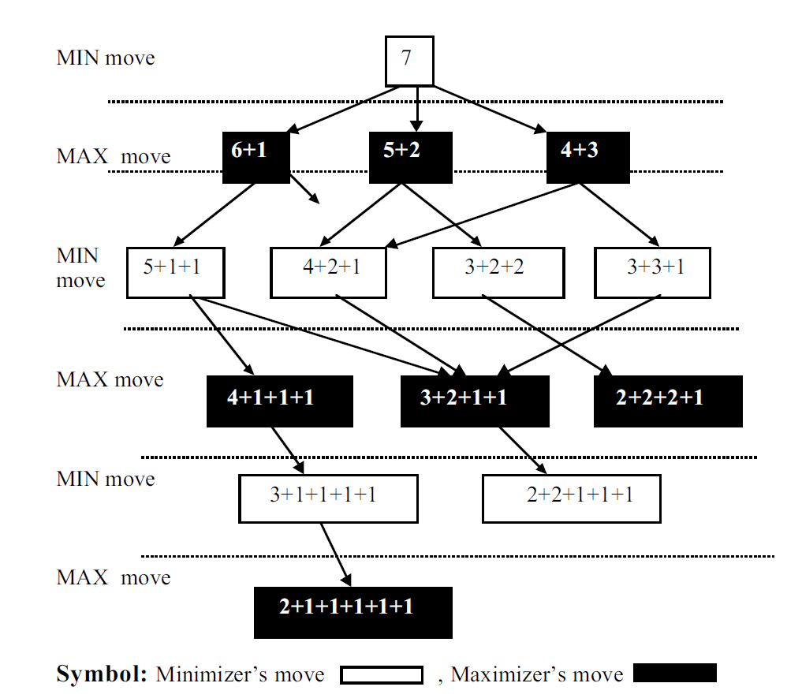
Note: MIN has three options to split 7 shown in next level
Note: MAX has 6 options to split shown in next level
Search for leaf nodes
Check whose tern to play the leaf node.
This player looses the game

Slide 33
MINMAX steps
Generate all possible moves (states) in a depth-first fashion. A graph is created.
Mark each level in the graph with either MAX or MIN in an ordered fashion
When you reach a leaf node. It means that you reached a wining, loosing, or tie state for either MAX or MIN depending on the mark of that level
Assign a wining state for MAX the value 1 and a loosing state for MAX a 0. If it was a wining state for MIN assign it a value of 0.
Propagate the values assigned to leaf nodes. to the upper levels until reaching the root node

Slide 34
Steps to remember
You need to propagate the values upwards starting from leaf node.
All the way to the root node. To do so, follow the following principles:
1) If you are going up from a MIN level to a MAX level, propagate the highest value of children
2) If you are going up from MAX level to a MIN level, propagate the lowest value of the children
3) If there is only one child then just propagate its value

Slide 35
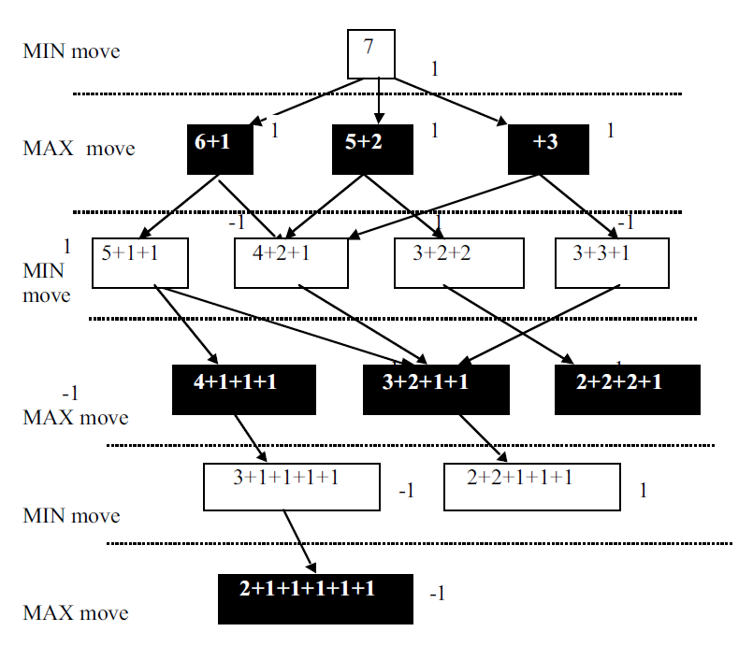
Computation in State Space

Slide 36
MINIMAX algorithm
Procedure MINIMAX
Begin
1. Expand the entire state-space below the starting node;
2. Assign values to the terminals of the state-space from
-1,0,+1}, depending on the success of the MINIMIZER draw, or the success of the MAXIMIZER respectively;
3. For each node whose all children possess values, do
Begin
if it is a MAXIMIZER node, then its value will be maximum of its childrens’ value; if it is a MINIMIZER node, then its value will be the minimum of its children;
End For;
End.

Slide 37
Pruning the Minimax Tree
Since we have limited time available, we want to avoid unnecessary computation in the minimax tree.
Pruning: ways of determining that certain branches will not be useful

Slide 38
Shallow and Deep Pruning
ROOT
ROOT
A
10
B
10
F
Max node
14
C
D
G
Min node
5
E
Shallow Cut-off
Deep Cut-off

Slide 39
α Cuts
If the current max value is greater than the successor’s min value, don’t explore that min subtree any more

Slide 40
Alpha-Beta Pruning
Alpha Bound of J:
  The highest current value of all MAX ancestors of J
  Exploration of a min node, J, is terminated as soon as its value equals or falls below alpha.
  In a min node, we update beta
Beta Bound of J:
  The lowest current value of all MIN ancestors of J
  Exploration of a max node, J, is terminated as soon as its value equals or exceeds beta
  In a max node, we update alpha
In both min and max nodes, we return when α ≥ β

Slide 41
Alpha-Beta Pruning
The two-parameter can be defined as:
Alpha: The best (highest-value) choice at any point along the path of Maximizer. The initial value of alpha is -∞.
Beta: The best (lowest-value) choice at any point along the path of Minimizer. The initial value of beta is +∞.

Slide 42
Key points about alpha-beta pruning:
The Max player will only update the value of alpha.
The Min player will only update the value of beta.
The condition for Alpha-beta Pruning is that α >= β.
While backtracking the tree, the node values will be passed to upper nodes instead of values of alpha and beta.
We will only pass the alpha, beta values to the child nodes.

Slide 43
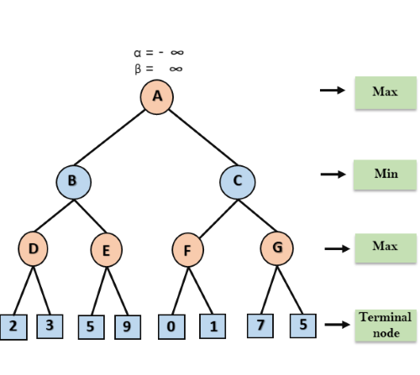
Step 1: At the first step the, Max player will start first move from node A where α= -∞ and β= +∞, these value of alpha and beta passed down to node B where again α= -∞ and β= +∞, and Node B passes the same value to its child D.

Slide 44
Step 2: At Node D, the value of α will be calculated as its turn for Max. The value of α is compared with firstly 2 and then 3, and the max (2, 3) = 3 will be the value of α at node D and node value will also 3.
Step 3: Now algorithm backtrack to node B, where the value of β will change as this is a turn of Min, Now β= +∞, will compare with the available subsequent nodes value, i.e. min (∞, 3) = 3, hence at node B now α= -∞, and β= 3.

Slide 45
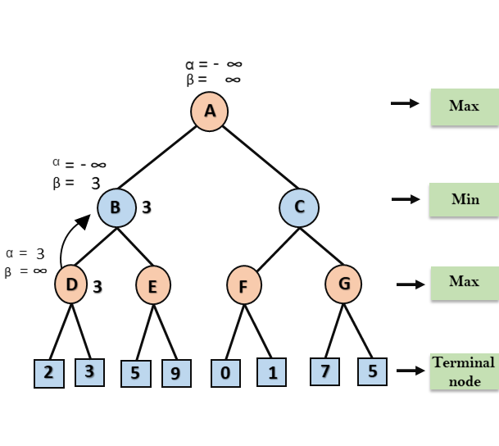
In the next step, algorithm traverse the next successor of Node B which is node E, and the values of α= -∞, and β= 3 will also be passed.

Slide 46
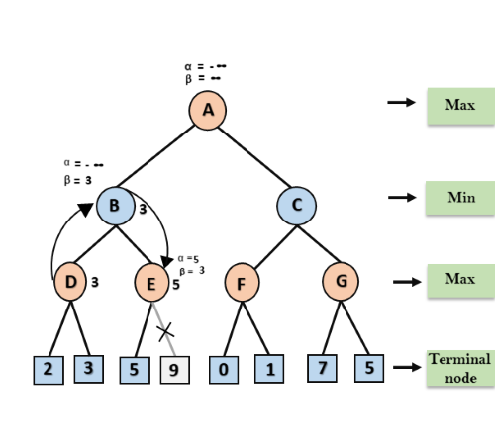
Step 4: At node E, Max will take its turn, and the value of alpha will change. The current value of alpha will be compared with 5, so max (-∞, 5) = 5, hence at node E α= 5 and β= 3, where α>=β, so the right successor of E will be pruned, and algorithm will not traverse it, and the value at node E will be 5.

Slide 47
Step 5: At next step, algorithm again backtrack the tree, from node B to node A. At node A, the value of alpha will be changed the maximum available value is 3 as max (-∞, 3)= 3, and β= +∞, these two values now passes to right successor of A which is Node C.
At node C, α=3 and β= +∞, and the same values will be passed on to node F.

Slide 48
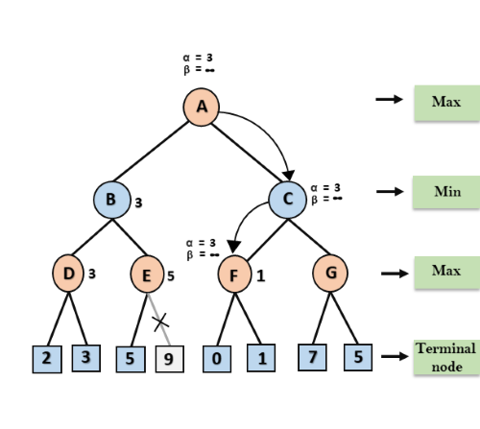
Step 6: At node F, again the value of α will be compared with left child which is 0, and max(3,0)= 3, and then compared with right child which is 1, and max(3,1)= 3 still α remains 3, but the node value of F will become 1.

Slide 49
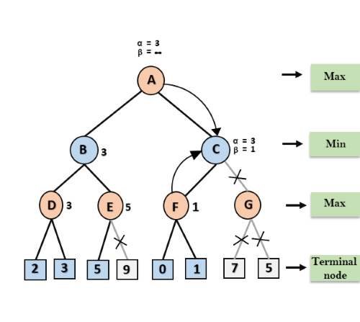
Step 7: Node F returns the node value 1 to node C, at C α= 3 and β= +∞, here the value of beta will be changed, it will compare with 1 so min (∞, 1) = 1. Now at C, α=3 and β= 1, and again it satisfies the condition α>=β, so the next child of C which is G will be pruned, and the algorithm will not compute the entire sub-tree G.

Slide 50
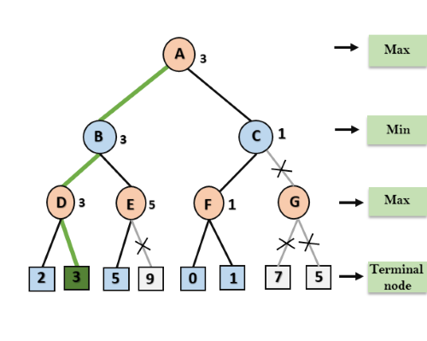
Step 8: C now returns the value of 1 to A here the best value for A is max (3, 1) = 3. Following is the final game tree which is the showing the nodes which are computed and nodes which has never computed. Hence the optimal value for the maximizer is 3 for this example.

Slide 51
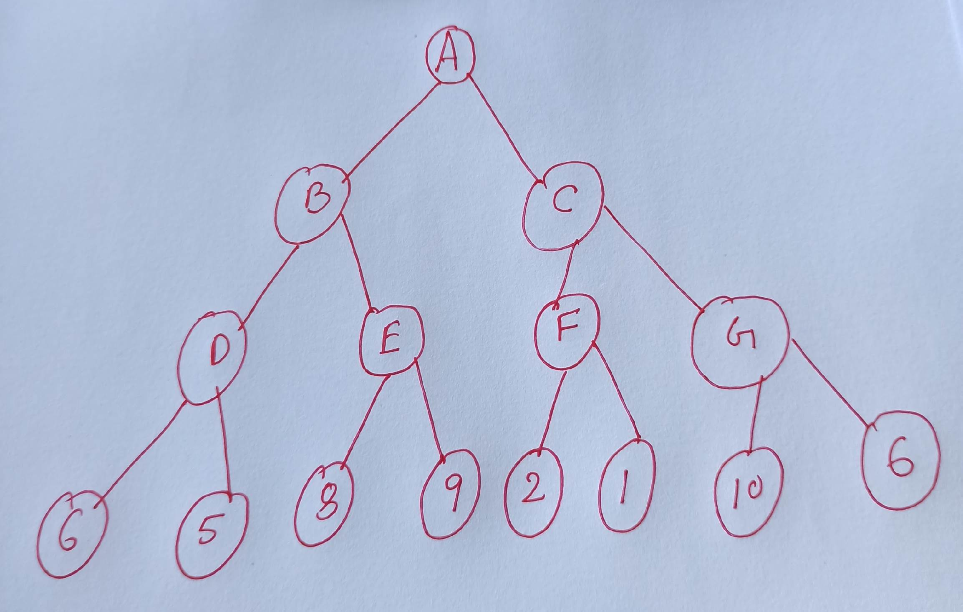
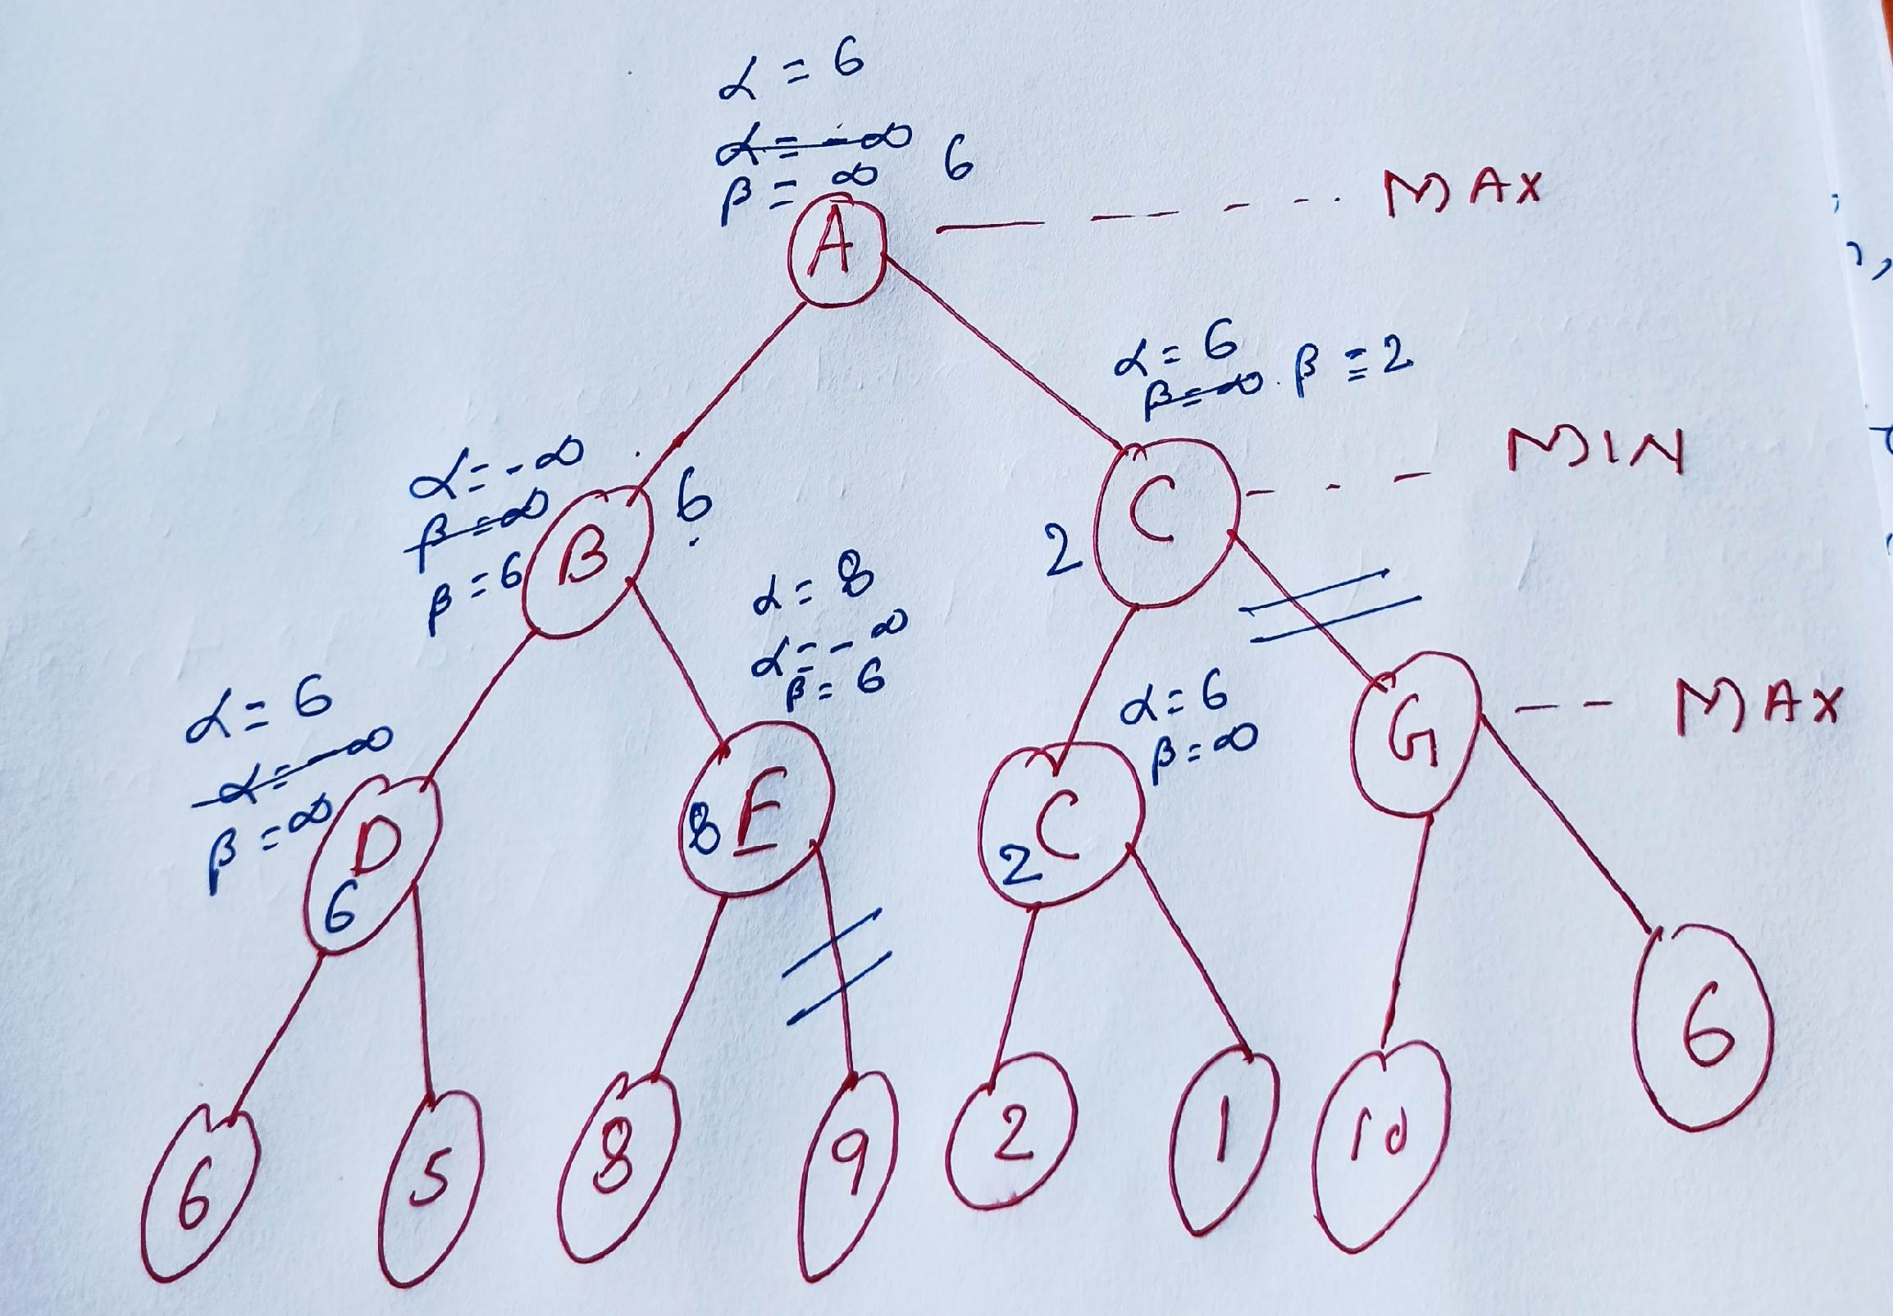

Slide 52
Alpha-Beta Procedure: V(J;α,β)
If J is a terminal, return V(J) = h(J).
If J is a max node:
  For each successor J_{k} of J in succession:
  Set α = max { α, V(J_{k}; α, β) }
  If α ≥ β then return β, else continue
  Return α
If J is a min node:
For each successor J_{k} of J in succession:
  Set β = min { β, V(J_{k}; α, β) }
  If α ≥ β then return α, else continue
  Return β

Slide 53
Max
Min
10
11
9
12
14
15
13
14
5
2
4
1
3
22
20
21

Slide 54
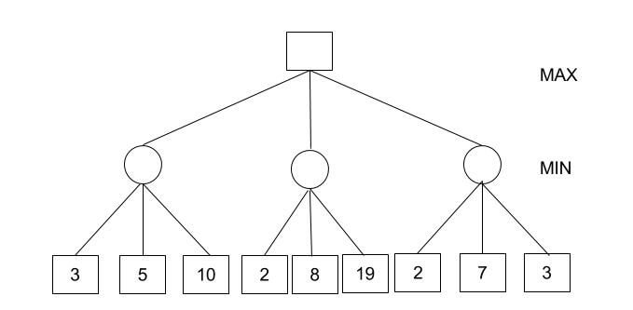
How does alpha-beta pruning work?

Slide 55
α Cut example
Max
-3
Min
-3
-4
-73
Max
21
-3
12
70
-4
100
-73
-14

Slide 56
α Cut example
Max
Min
Max
21
-3
12
-70
-4
100
-73
-14
Depth first search along path 1

Slide 57
α Cut example
Max
Min
21
Max
21
-3
12
-70
-4
100
-73
-14
21 is minimum so far (second level)
Can’t evaluate yet at top level

Slide 58
α Cut example
Max
-3
Min
-3
Max
21
-3
12
-70
-4
100
-73
-14
-3 is minimum so far (second level)
-3 is maximum so far (top level)

Slide 59
α Cut example
Max
-3
Min
-3
12
Max
21
-3
12
-70
-4
100
-73
-14
12 is minimum so far (second level)
-3 is still maximum (can’t use second node yet)

Slide 60
α Cut example
Max
-3
Min
-3
-70
Max
21
-3
12
-70
-4
100
-73
-14
-70 is now minimum so far (second level)
-3 is still maximum (can’t use second node yet)

Slide 61
α Cut example
Max
-3
Min
-3
-70
Max
21
-3
12
-70
-4
100
-73
-14
Since second level node will never be > -70, it will never be chosen by the previous level
We can stop exploring that node

Slide 62
α Cut example
Max
-3
Min
-3
-70
-73
Max
21
-3
12
-70
-4
100
-73
-14
Evaluation at second level is again -73

Slide 63
α Cut example
Max
-3
Min
-3
-70
-73
Max
21
-3
12
-70
-4
100
-73
-14
Again, can apply α cut since the second level node will never be > -73, and thus will never be chosen by the previous level

Slide 64
α Cut example
Max
-3
Min
-3
-70
-73
Max
21
-3
12
-70
-4
100
-73
-14
As a result, we evaluated the Max node without evaluating several of the possible paths

Slide 65
β cuts
Similar idea to α cuts, but the other way around
If the current minimum is less than the successor’s max value, don’t look down that max tree any more

Slide 66
β Cut example
Min
21
Max
21
70
73
Min
21
-3
12
70
-4
100
73
-14
Some subtrees at second level already have values > min from previous, so we can stop evaluating them.

Slide 67
Move Ordering in Pruning
Worst Ordering: In some cases of alpha beta pruning none of the node pruned by the algorithm and works like standard minimax algorithm. This consumes a lot of time as because of alpha and beta factors and also not gives any effective results. This is called Worst ordering in pruning. In this case, the best move occurs on the right side of the tree.
Ideal Ordering: In some cases of alpha beta pruning lot of the nodes pruned by the algorithm. This is called Ideal ordering in pruning. In this case, the best move occurs on the left side of the tree. We apply DFS hence it first search left of the tree and go deep twice as minimax algorithm in the same amount of time.

Slide 68
Rules to find Good ordering
The best move happens from the lowest node
Use domain knowledge while finding the best move
Order of nodes should be in such a way that the best nodes will be computed first

Slide 69
α-β Pruning
Pruning by these cuts does not affect final result
  May allow you to go much deeper in tree
“Good” ordering of moves can make this pruning much more efficient
  Evaluating “best” branch first yields better likelihood of pruning later branches
  Perfect ordering reduces time to b^{m/2}
    i.e., doubles the depth you can search to!

Slide 70
α-β Pruning
Can store information along an entire path, not just at most recent levels!
Keep along the path:
  α: best MAX value found on this path
  (initialize to most negative utility value)
  β: best MIN value found on this path
  (initialize to most positive utility value)

Slide 71
Pruning at MAX node
α is possibly updated by the MAX of successors evaluated so far
If the value that would be returned is ever > β, then stop work on this branch
If all children are evaluated without pruning, return the MAX of their values

Slide 72
Idea of α-β Pruning
Min
21
Max
21
Min
21
-3
70
Max
We know β on this path is 21
So, when we get max=70, we know this will never be used, so we can stop here
12
70
-4
100

Slide 73
Pruning at MIN node
β is possibly updated by the MIN of successors evaluated so far
If the value that would be returned is ever < α, then stop work on this branch
If all children are evaluated without pruning, return the MIN of their values

Slide 74
Utility Evaluation Function
Game-specific!
  Take into account knowledge about game
“Stupid” utility
  1 if player 1 (max) wins
  -1 if player 0 (min) wins
  0 if tie (or unknown)
  Only works if we can evaluate complete tree
  But, should form a basis for other evaluations

Slide 75
Utility Evaluation
Need to assign a numerical value to the state
Typically assign numerical values to lots of individual factors …
  Example for chess:
    a = # player 1’s pieces - # player 2’s pieces
    b = 1 if player 1 has queen and player 2 does not, -1 if the opposite, or 0 if the same
    c = 2 if player 1 has 2-rook advantage, 1 if a 1-rook advantage, etc.
… and combine them by some function

Slide 76
Utility Evaluation
Notice: quality of utility function is based on:
  What features are evaluated
  How those features are scored
  How the scores are weighted/combined
Absolute utility value doesn’t matter – relative value does.

Slide 77
Evaluation functions
If you had a perfect utility evaluation function, what would it mean about the minimax tree?

Slide 78
Evaluation functions
If you had a perfect utility evaluation function, what would it mean about the minimax tree?
You would never have to evaluate more than one level deep!
Typically, you can’t create such perfect utility evaluations, though.

Slide 79
Evaluation Functions for Ordering
As mentioned earlier, order of branch evaluation can make a big difference in how well you can prune
A good evaluation function might help you order your available moves
  Perform one move only
  Evaluate board at that level
  Recursively evaluate branches in order from best first move to worst first move (or vice-versa if at a MIN node)

